Slide 1

SOLID MECHANICS Jan 2025 to Apr 2025
Module - 4
Dr. Rajendra Kumar Varma
Associate Professor,
Dept. of Civil Engineering
IIT Jammu

Slide 2
Contents…
Shear-force and bending moment diagrams
Differential Equation of Flexure (2nd and 4th order equations)
Relationship between Loads, Shear Force, Bending Moment and Deflection
Deflection by twice integration method
Deflections by integration of the shear-force and load equations (4 ^{th} order equations)
Macaulay's method
Method of superposition for obtaining deflections in complex loading and support conditions

Slide 3
Shear Force and Bending Moment Diagrams

Slide 4
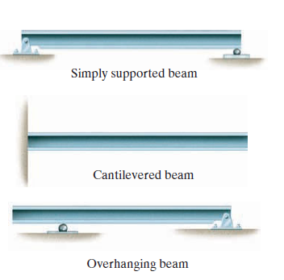
Beams
Horizontal members supporting loadings perpendicular to their longitudinal axis.
Classification based on Support type:
Simply Supported Beam – Pinned at one end and pinned or roller-supported at the other
Fixed Beam – Fixed at both the ends
Cantilevered Beam – Fixed at one end and free at the other
Overhanging Beam – One or both ends extend beyond the supports

Slide 5
Support Reactions
Fy
Fy
Fy
Fx
Fx
Mz
Fixed Support
Pinned Support
Roller Support

Slide 6
Importance of Beams
Among the most crucial structural elements.
Provide support in various applications, including:
Floors of buildings
Bridge decks
Aircraft wings
Automobile axles
Human bones (as natural beams)

Slide 7
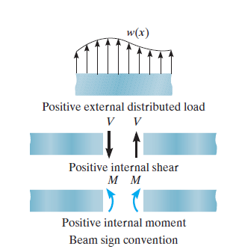
Beam Sign Conventions
Purpose: Establishes a convention to define positive and negative values for shear force (V) and bending moment (M).
Choice of Sign Convention: Arbitrary, but the standard engineering practice is typically used.
Positive Directions:
Distributed Load: Acts upward on the beam.

Slide 8
Beam Sign Conventions …(cont’d)
Internal Shear Force: Causes a clockwise rotation of the beam segment.
Internal Moment: Causes compression in the top fibers of the beam, bending the segment into a shape that can hold water.
Negative Directions:
Any loading opposite to the positive directions is considered negative.

Slide 9
Procedure for Analysis
1. Support Reactions
Determine all reactions and couple moments acting on the beam.
Resolve all forces into components acting perpendicular and parallel to the beam’s axis.
2. Shear and Moment Functions
Use separate coordinates x-x’, starting from the left end of the beam.
Define x-x’ for regions between concentrated forces, couple moments, or where distributed loading changes.

Slide 10
Procedure for Analysis …(cont’d)
At each distance x-x’, draw the free-body diagram of a beam segment, ensuring Shear force V and moment M act in their positive sense (following the sign convention)
Calculate shear force V by summing forces perpendicular to the beam’s axis.
To eliminate V, calculate moment M by summing moments about the sectioned end of the segment.

Slide 11
Procedure for Analysis …(cont’d)
3. Shear and Moment Diagrams
Plot Shear Force Diagram (V vs x) and Bending Moment Diagram (M vs x).
Positive values of V and M are plotted above the x-axis, and negative values are plotted below the x-axis.
Typically, it is more convenient to plot shear and moment diagrams below the beam’s free-body diagram for better explanation and understanding.

Slide 12
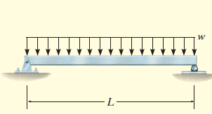
Example 1
Draw the shear force and bending moment diagram as shown in the figure below.

Slide 13
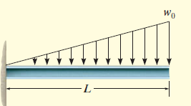
Example 2
Draw the shear force and bending moment diagram as shown in the figure given below.

Slide 14
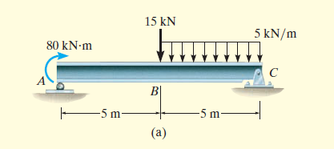
Example 3
Draw the shear force and bending moment diagram as shown in figure given below.

Slide 15
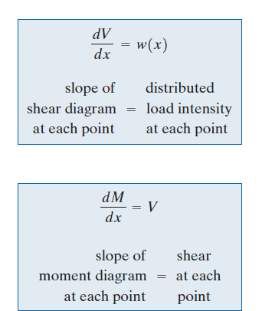
Graphical method for constructing the Shear Force and Bending Moment diagrams
Regions of Distributed Load (Brief Explanation)
Analyse a small beam segment Δx subjected to arbitrary loading.
Choose the segment where no concentrated forces or moments act.
Loading Directions follow the positive sign convention.
…Eq (1)
…Eq (2)

Slide 16
Graphical method for constructing the Shear Force and Bending Moment diagrams
Internal shear force and moment change slightly on the right face to maintain equilibrium.
Distributed load is replaced by a resultant force w(x) Δx
Acts at a fractional distance k(Δx) from the right side.
For uniform loading, k=1/2
Use equilibrium equations to find shear force and bending moment.

Slide 17
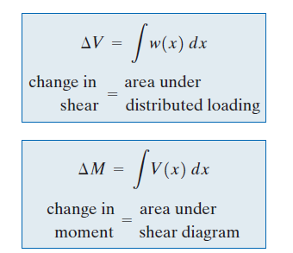
Graphical method for constructing the Shear Force and Bending Moment diagrams …(cont’d)
Equations 1 and 2 may be rewritten also as:

Slide 18
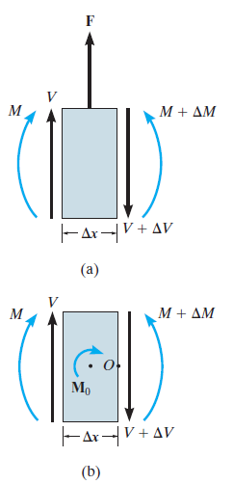
Regions of concentrated forces and moment
Concentrated Force :
Force equilibrium equation: ∑Fy=0→ΔV=F
Effect on Shear Diagram: If force F acts upward → Shear diagram "jumps" upward (positive jump).
If force F acts downward → Shear diagram "jumps" downward (negative jump).

Slide 19
Regions of concentrated forces and moment
Concentrated Moment :
Moment equilibrium equation: ∑MO=0→ΔM=M0
Effect on Moment Diagram:
If moment M acts clockwise → Moment diagram "jumps" upward (positive jump).
If moment M acts counter clockwise → Moment diagram "jumps" downward (negative jump).

Slide 20
Procedure for Analysis
Support Reactions:
Calculate support reactions.
Resolve forces into components perpendicular and parallel to the beam’s axis.
Shear Diagram:
Plot known shear values at both ends of the beam on the V vs. x axis.
The slope of the shear diagram is equal to the distributed load w, (dV/dx=w)
w is positive when acting upward.

Slide 21
Procedure for Analysis …(cont’d)
To find shear at a point:
Use the method of sections and force equilibrium equation, OR
Use the integral formula: ΔV=∫w(x) dx→ Change in shear = Area under the load diagram.

Slide 22
Procedure for Analysis …(cont’d)
Moment Diagram:
Plot known moment values at both ends of the beam on the M vs. x axis.
The slope of the moment diagram equals the shear (dM/dx=V).
At points where shear = 0, dM/dx=0 → Maximum or minimum moment.
To find moment at a point:
Use the method of sections and moment equilibrium equation.
OR use the integral formula: ΔM=∫V(x) dx → Change in moment = Area under the shear diagram.

Slide 23
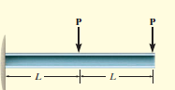
Example 4
Draw the shear and moment diagrams for the figure given below.

Slide 24

Example 5
Draw the shear and moment diagrams for figure given below.

Slide 25
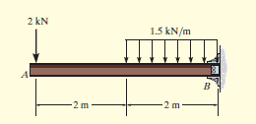
Example 6
Draw the shear and moment diagrams for the figure given below.

Slide 26
Differential Equation of Flexure & Relationship between Load, Shear Force and Bending Moment

Slide 27
Key Concepts
Flexural Rigidity (𝐸𝐼): 𝐸 is the Young's modulus (material stiffness) and 𝐼 is the second moment of area (a geometric property of the beam’s cross-section).
Beam Deflection (𝑦(𝑥)): The vertical displacement of the beam as a function of the horizontal position 𝑥.
Bending Moment (𝑀(𝑥): The internal moment within the beam at a given point.
Shear Force (𝑉(𝑥)): The internal shear force along the beam.
Distributed Load (𝑞(𝑥)): The external load applied per unit length

Slide 28
Assumptions
The beam is slender (length is much greater than its cross-sectional dimensions).
Plane sections remain plane and perpendicular to the neutral axis (Euler-Bernoulli Beam Theory).
Deflections are small.
Beams are in linear elasticity.

Slide 29
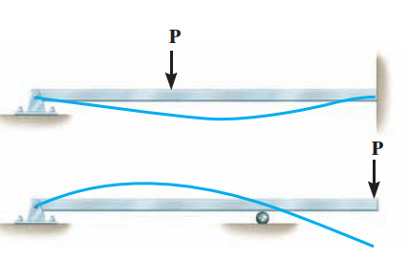
Elastic Curve
The deflection curve of the longitudinal axis that passes through the centroid of each cross-sectional area of a beam is called the elastic curve.
The deflection depend on the boundary condition also.
Positive internal moment tends to bend the beam concave upward
Negative moment tends to bend the beam concave downward,

Slide 30
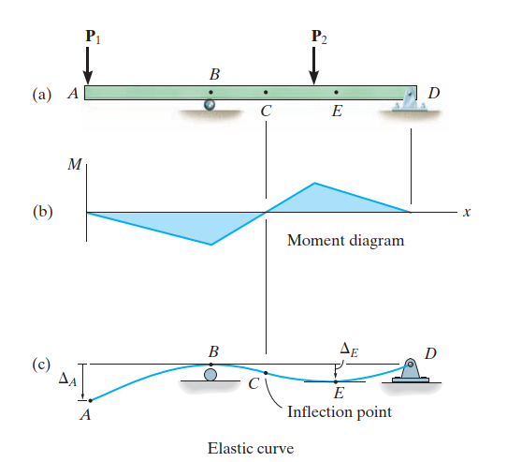
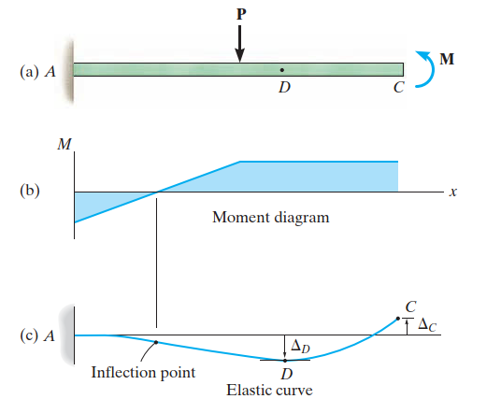
Elastic Curve

Slide 31
Moment-Curvature Relationship
The x axis extends +ve to the right, (initial straight longitudinal axis of the beam)
It is used to locate the differential element, having an undeformed width dx.
The v axis is +ve upwards measures the displacement of the elastic curve.

Slide 32
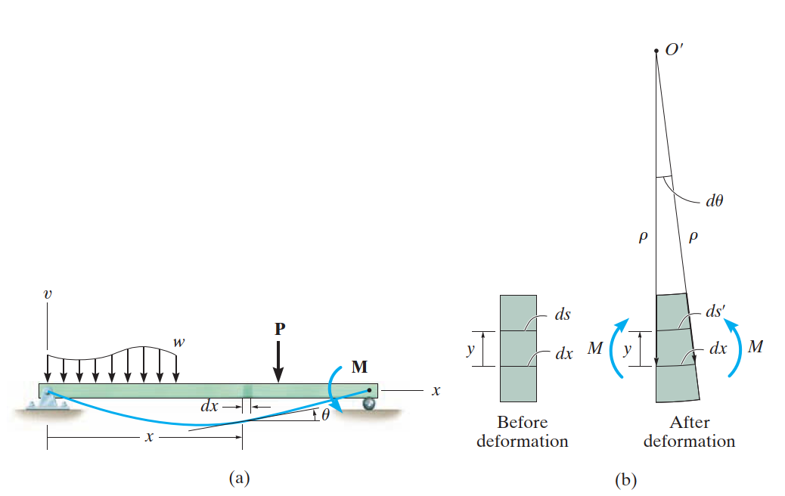
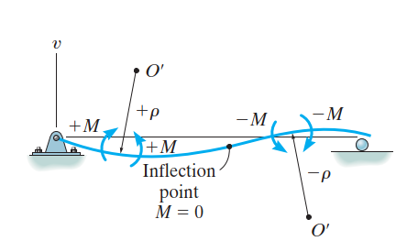

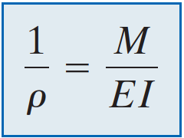
Moment Curvature Relations

Slide 33
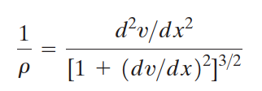
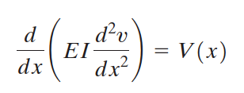
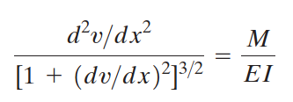
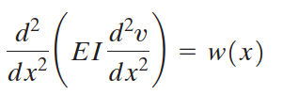

Slope and Displacement by Integration

Slide 34
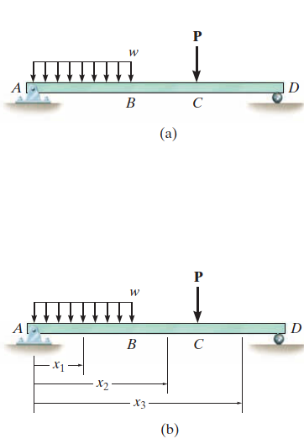
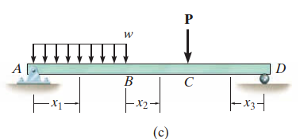
Displacement and Slope Calculation
The coordinates for calculation of Moment can be arbitrary.

Slide 35
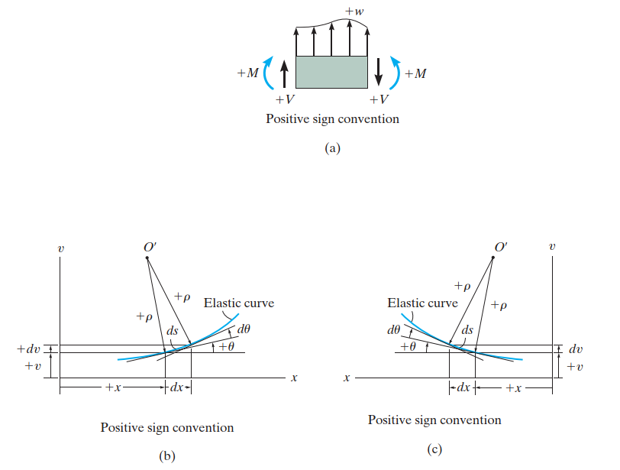
Sign Convention

Slide 36
Curvature
Curvature measures how much a curve deviates from being a straight line. For a beam undergoing bending, the curvature is related to the change in slope along its length.
The general expression for curvature k described by $y=y(x)$is given by:
$$k=\frac{dθ}{ds}$$
Where:
k = Curvature
𝜃 = Slope angle (rotation of the beam cross-section) $=\frac{dy}{dx}$
s = Arc length along the deflected shape

Slide 37
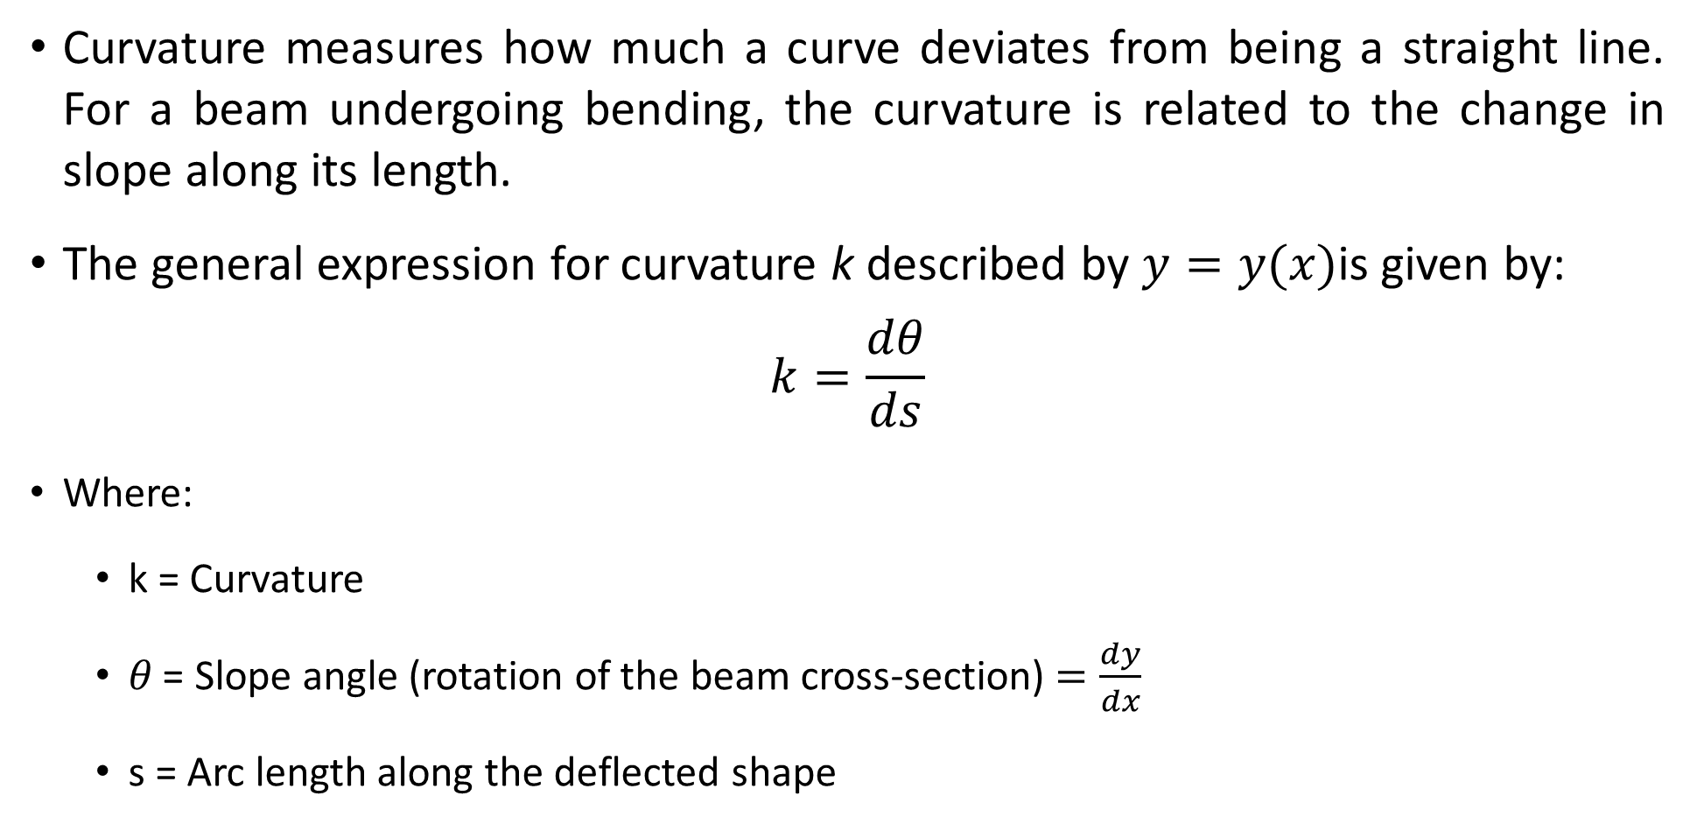
Curvature
Curvature measures how much a curve deviates from being a straight line. For a beam undergoing bending, the curvature is related to the change in slope along its length.
The general expression for curvature k described by $y=y(x)$is given by:
$$k=\frac{dθ}{ds}$$
Where:
k = Curvature
𝜃 = Slope angle (rotation of the beam cross-section) $=\frac{dy}{dx}$
s = Arc length along the deflected shape

Slide 38
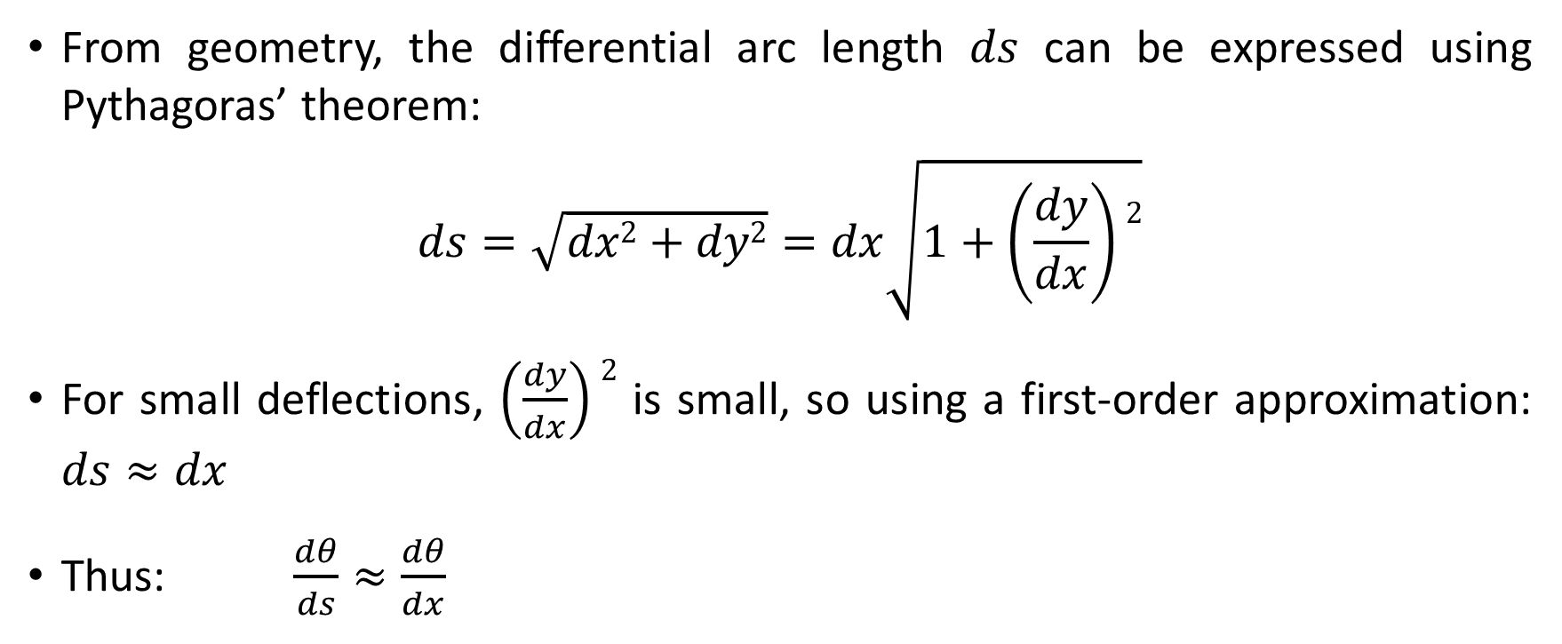
Differential Arc Length
From geometry, the differential arc length 𝑑𝑠 can be expressed using Pythagoras’ theorem:
$$ds=\sqrt{dx2+dy2}=dx\sqrt{1+\left(\frac{dy}{dx}\right)2}$$
For small deflections, $\left(\frac{dy}{dx}\right)2$ is small, so using a first-order approximation: $ds≈dx$
Thus: $\frac{dθ}{ds}≈\frac{dθ}{dx}$

Slide 39
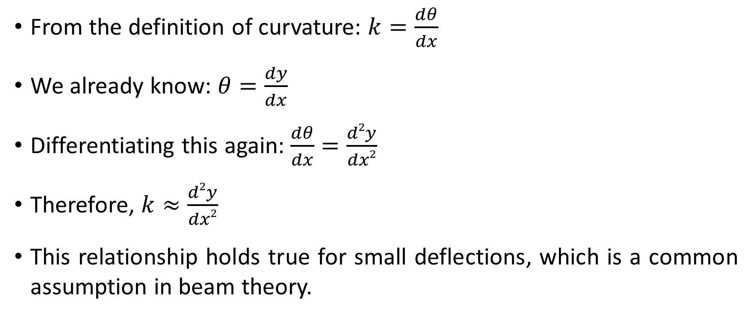
Relating the Curvature to the Beam's Geometry
From the definition of curvature: $k=\frac{dθ}{dx}$
We already know: $θ=\frac{dy}{dx}$
Differentiating this again: $\frac{dθ}{dx}=\frac{d2y}{dx2}$
Therefore, $k≈\frac{d2y}{dx2}$
This relationship holds true for small deflections, which is a common assumption in beam theory.

Slide 40
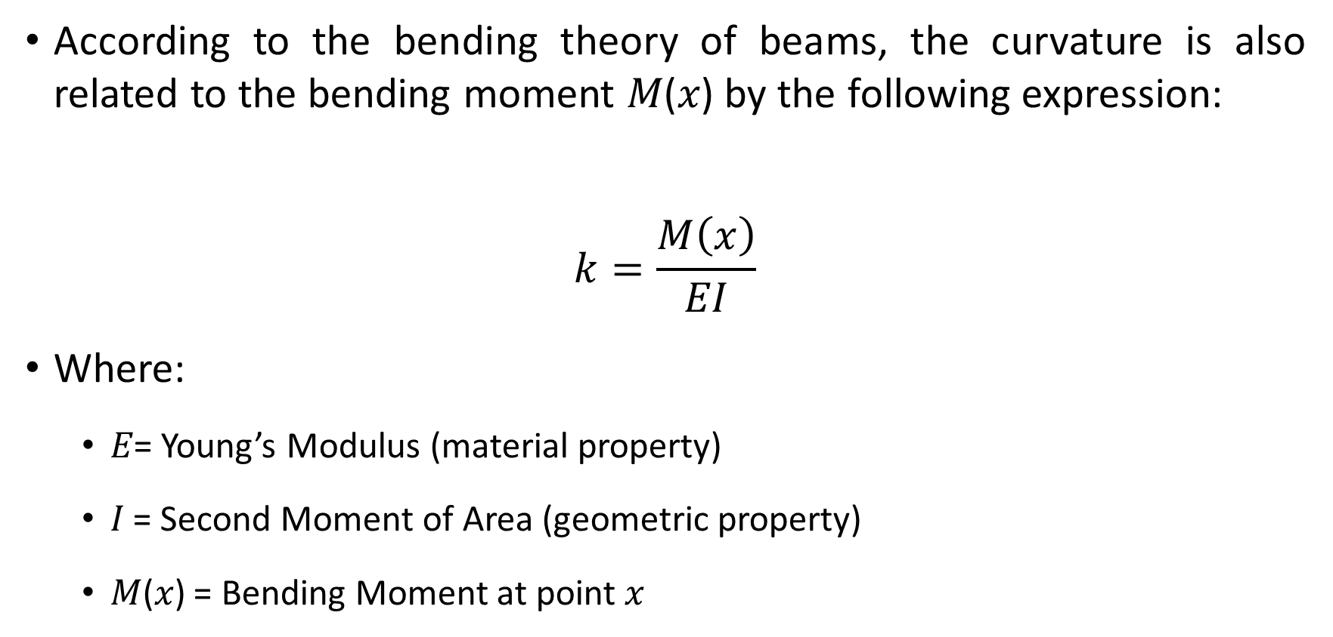
Including Material and Geometric Properties
According to the bending theory of beams, the curvature is also related to the bending moment 𝑀(𝑥) by the following expression:
$$k=\frac{M\left(x\right)}{EI}$$
Where:
𝐸= Young’s Modulus (material property)
𝐼 = Second Moment of Area (geometric property)
𝑀(𝑥) = Bending Moment at point 𝑥

Slide 41
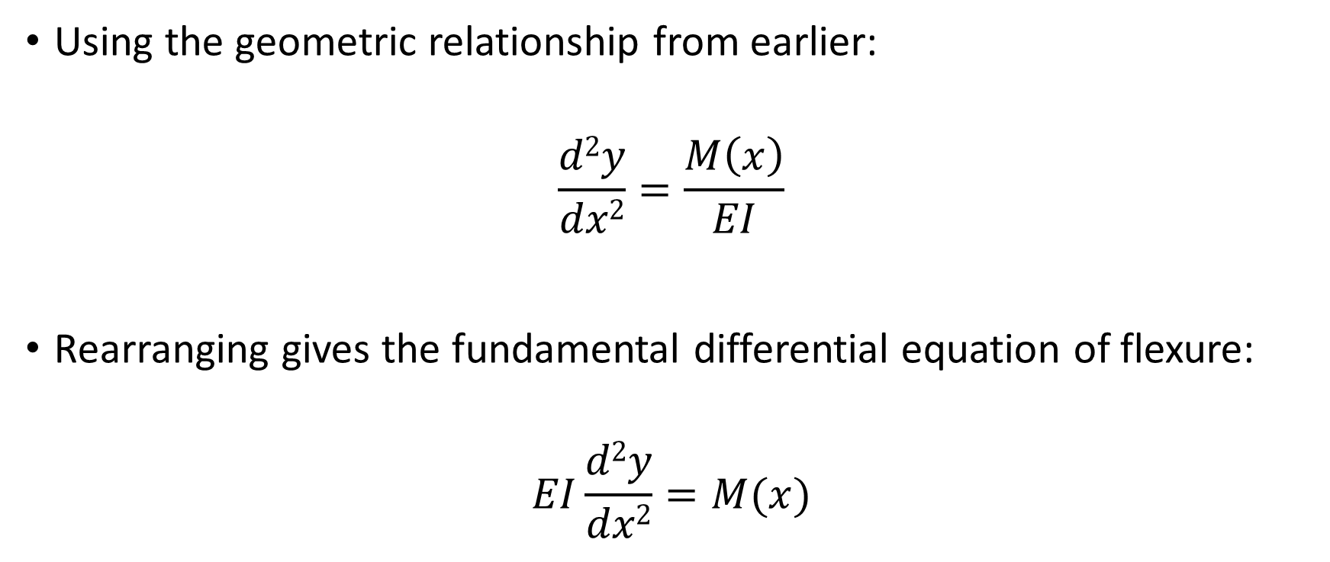
Including Material and Geometric Properties …(cont’d)
Using the geometric relationship from earlier:
$$\frac{d2y}{dx2}=\frac{M\left(x\right)}{EI}$$
Rearranging gives the fundamental differential equation of flexure:
$$EI\frac{d2y}{dx2}=M(x)$$

Slide 42
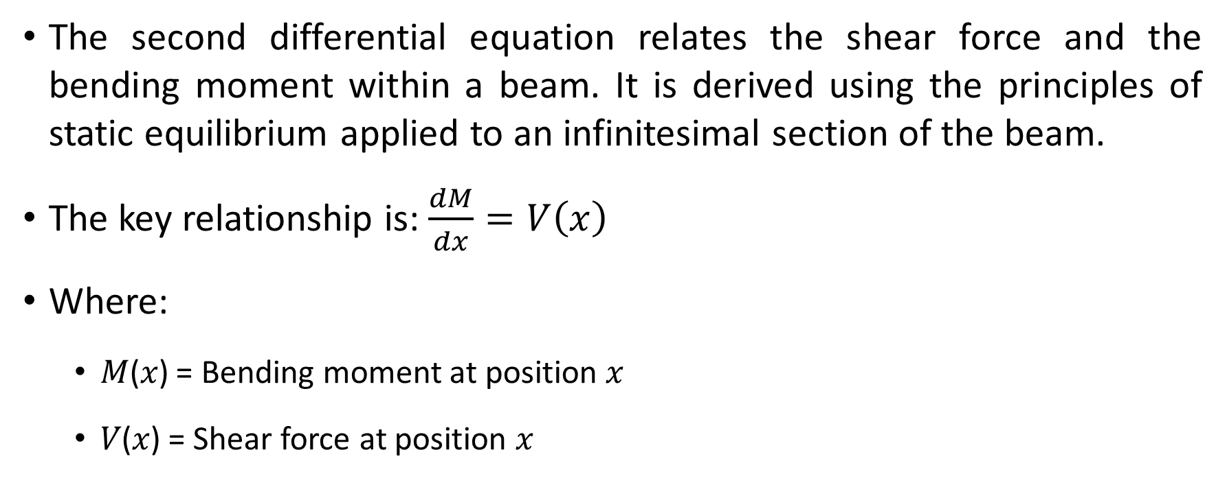
Derivation of the Second Differential Equation of Flexure
The second differential equation relates the shear force and the bending moment within a beam. It is derived using the principles of static equilibrium applied to an infinitesimal section of the beam.
The key relationship is: $\frac{dM}{dx}=V\left(x\right)$
Where:
𝑀(𝑥) = Bending moment at position 𝑥
𝑉(𝑥) = Shear force at position 𝑥

Slide 43

Derivation of the Second Differential Equation of Flexure …(cont’d)
Then, further applying equilibrium:
$$\frac{dV}{dx}=−q\left(x\right)$$
Where:
q(x) = Distributed load per unit length (positive if acting downward)

Slide 44
Derivation (Consider a Small Beam Element)
Take an infinitesimal beam element of length 𝑑𝑥.
The left side of the element has a Shear Force 𝑉(𝑥) and a Bending Moment 𝑀(𝑥).
The right side has 𝑉(𝑥+𝑑𝑥) and 𝑀(𝑥+𝑑𝑥).
A distributed load 𝑞(𝑥) acts along the element.
From its Free Body Diagram:
Shear Forces: 𝑉(𝑥) and 𝑉(𝑥+𝑑𝑥)
Bending Moments: 𝑀(𝑥) and 𝑀(𝑥+𝑑𝑥)
External Load: 𝑞(𝑥)⋅𝑑𝑥

Slide 45
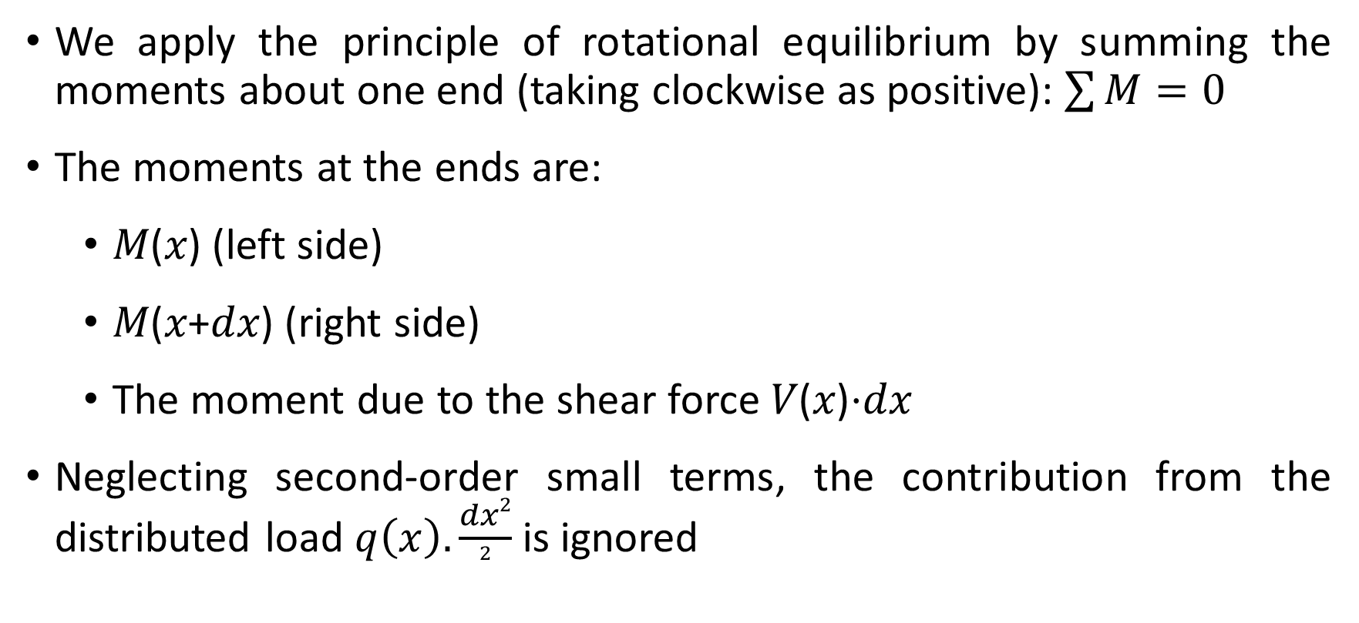
Derivation (Apply Moment Equilibrium)
We apply the principle of rotational equilibrium by summing the moments about one end (taking clockwise as positive): $\sum{M=0}$
The moments at the ends are:
𝑀(𝑥) (left side)
𝑀(𝑥+𝑑𝑥) (right side)
The moment due to the shear force 𝑉(𝑥)⋅𝑑𝑥
Neglecting second-order small terms, the contribution from the distributed load $q\left(x\right).\frac{dx2}{2}$ is ignored

Slide 46
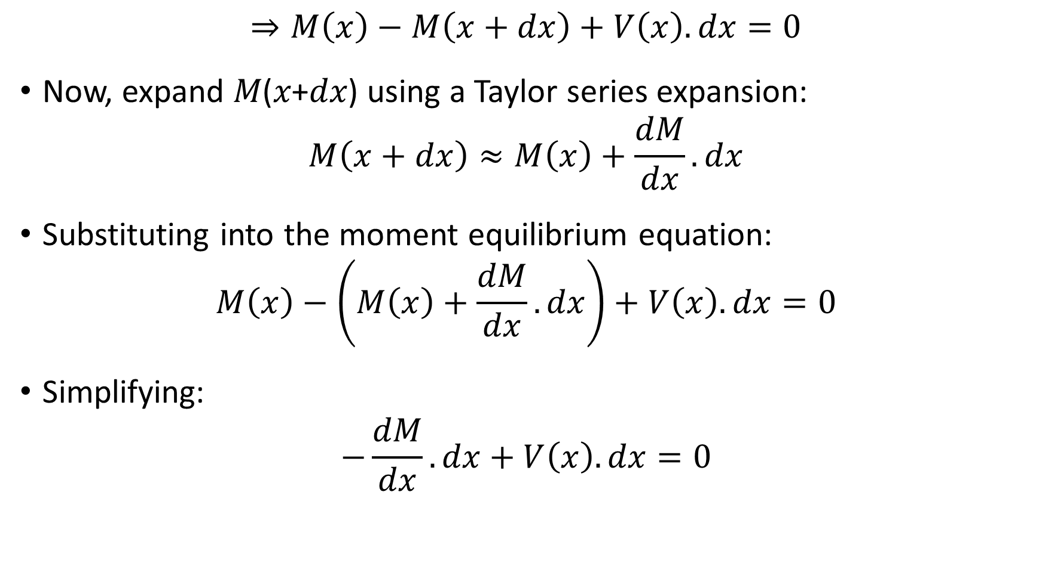
Derivation (Apply Moment Equilibrium) …(cont’d)
$$⇒M\left(x\right)−M\left(x+dx\right)+V\left(x\right).dx=0$$
Now, expand 𝑀(𝑥+𝑑𝑥) using a Taylor series expansion:
$$M\left(x+dx\right)≈M\left(x\right)+\frac{dM}{dx}.dx$$
Substituting into the moment equilibrium equation:
$$M\left(x\right)−\left(M\left(x\right)+\frac{dM}{dx}.dx\right)+V\left(x\right).dx=0$$
Simplifying:
$$−\frac{dM}{dx}.dx+V\left(x\right).dx=0$$

Slide 47
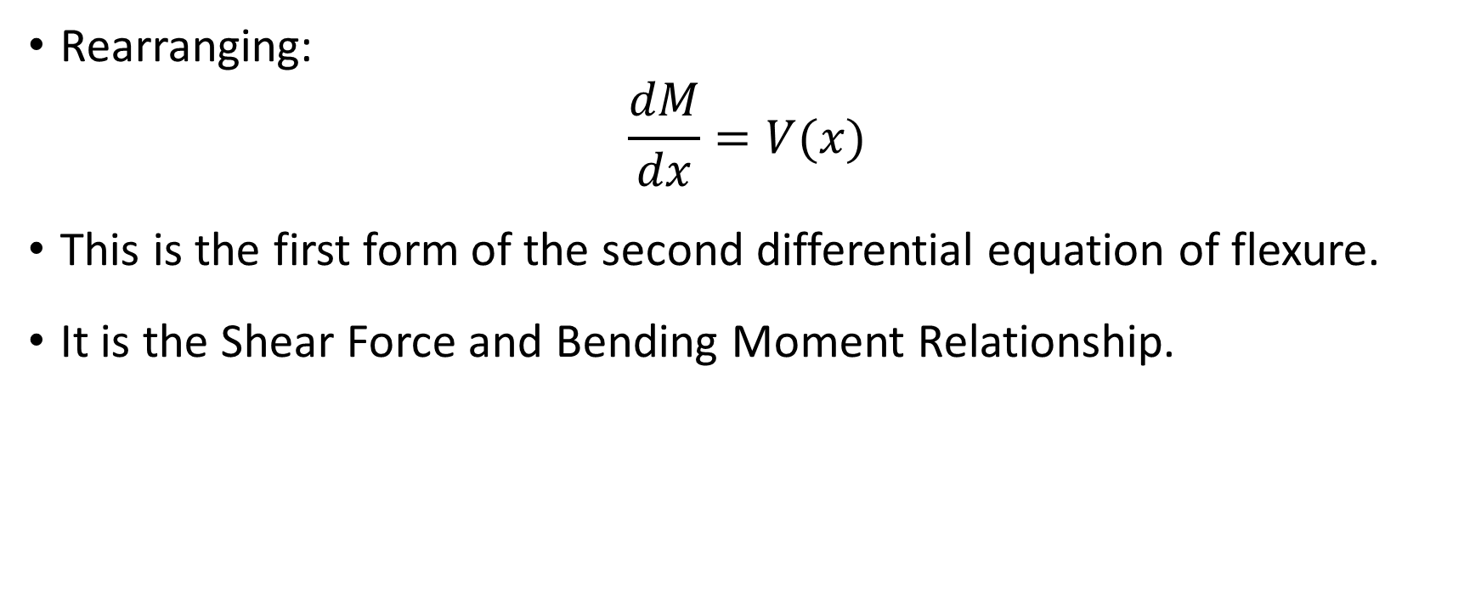
Derivation (Apply Moment Equilibrium) …(cont’d)
Rearranging:
$$\frac{dM}{dx}=V(x)$$
This is the first form of the second differential equation of flexure.
It is the Shear Force and Bending Moment Relationship.
It shows that the rate of change of the bending moment is equal to the shear force at the section.

Slide 48
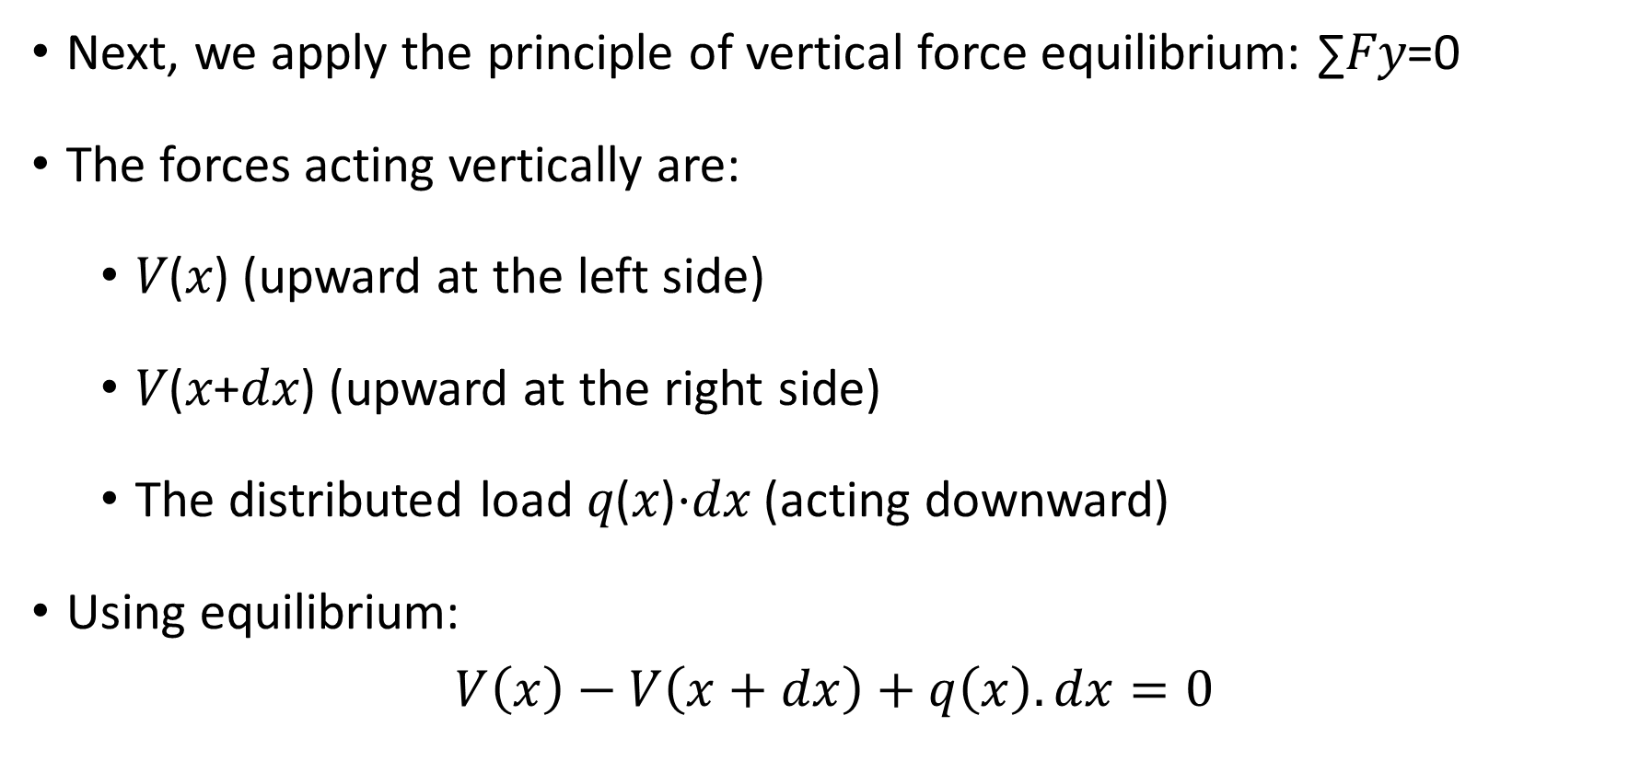
Derivation (Apply Vertical Force Equilibrium)
Next, we apply the principle of vertical force equilibrium: ∑𝐹𝑦=0
The forces acting vertically are:
𝑉(𝑥) (upward at the left side)
𝑉(𝑥+𝑑𝑥) (upward at the right side)
The distributed load 𝑞(𝑥)⋅𝑑𝑥 (acting downward)
Using equilibrium:
$$V\left(x\right)−V\left(x+dx\right)+q\left(x\right).dx=0$$

Slide 49
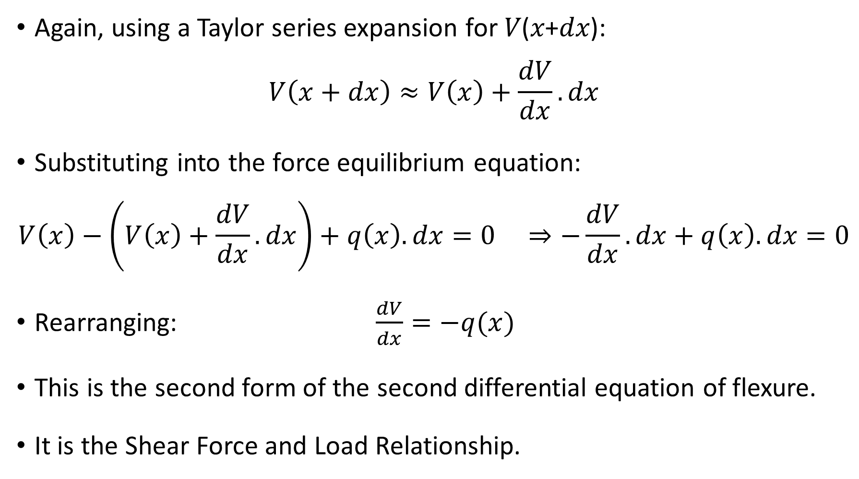
Derivation (Apply Vertical Force Equilibrium) cont’d)
Again, using a Taylor series expansion for 𝑉(𝑥+𝑑𝑥):
$$V\left(x+dx\right)≈V\left(x\right)+\frac{dV}{dx}.dx$$
Substituting into the force equilibrium equation:
$$V\left(x\right)−\left(V\left(x\right)+\frac{dV}{dx}.dx\right)+q\left(x\right).dx=0 ⇒−\frac{dV}{dx}.dx+q\left(x\right).dx=0$$
Rearranging: $\frac{dV}{dx}=−q(x)$
This is the second form of the second differential equation of flexure.
It is the Shear Force and Load Relationship.
It shows that the rate of change of shear force is equal to the rate of change of loading.

Slide 50
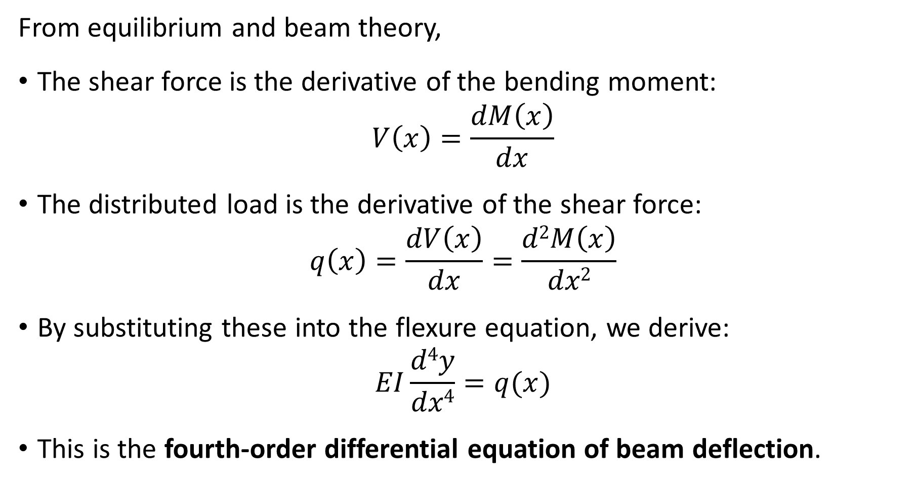

Relationship with Shear Force and Load
From equilibrium and beam theory,
The shear force is the derivative of the bending moment:
$$V\left(x\right)=\frac{dM\left(x\right)}{dx}$$
The distributed load is the derivative of the shear force:
$$q\left(x\right)=\frac{dV\left(x\right)}{dx}=\frac{d2M\left(x\right)}{dx2}$$
By substituting these into the flexure equation, we derive:
$$EI\frac{d4y}{dx4}=q(x)$$
This is the fourth-order differential equation of beam deflection.
$$EI\frac{d2y}{dx2}=M(x)$$
flexure equation

Slide 51
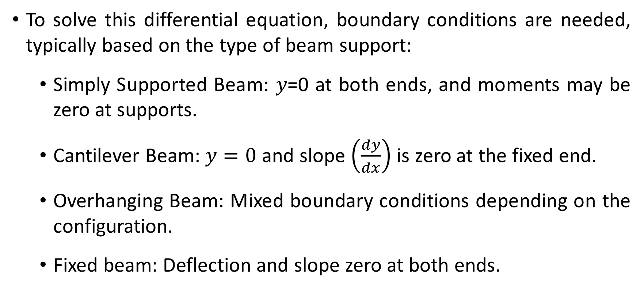
Boundary Conditions
To solve this differential equation, boundary conditions are needed, typically based on the type of beam support:
Simply Supported Beam: 𝑦=0 at both ends, and moments may be zero at supports.
Cantilever Beam: $y=0$ and slope $\left(\frac{dy}{dx}\right)$ is zero at the fixed end.
Overhanging Beam: Mixed boundary conditions depending on the configuration.
Fixed beam: Deflection and slope zero at both ends.

Slide 52
Relationship Between Load, Shear Force and Bending Moment

Slide 53
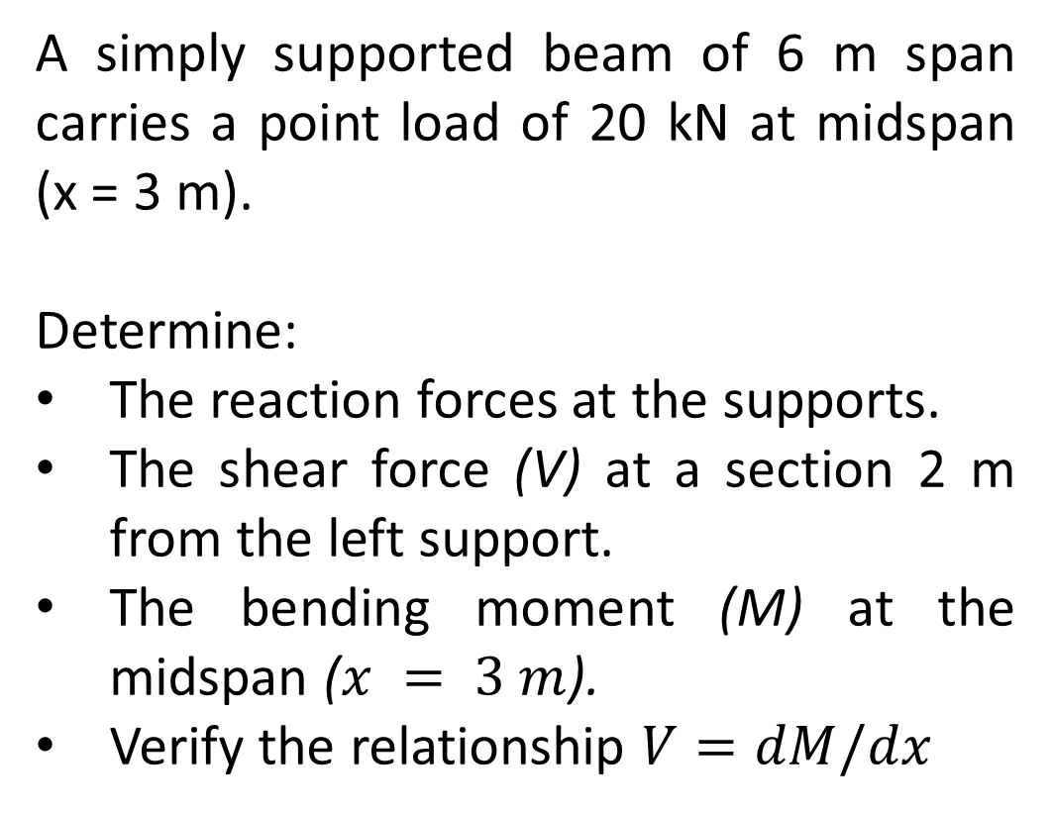
Example 7
A simply supported beam of 6 m span carries a point load of 20 kN at midspan (x = 3 m).
Determine:
The reaction forces at the supports.
The shear force (V) at a section 2 m from the left support.
The bending moment (M) at the midspan ($x = 3 m$).
Verify the relationship $V=dM/dx$
20 KN
3m
3m
6m

Slide 54
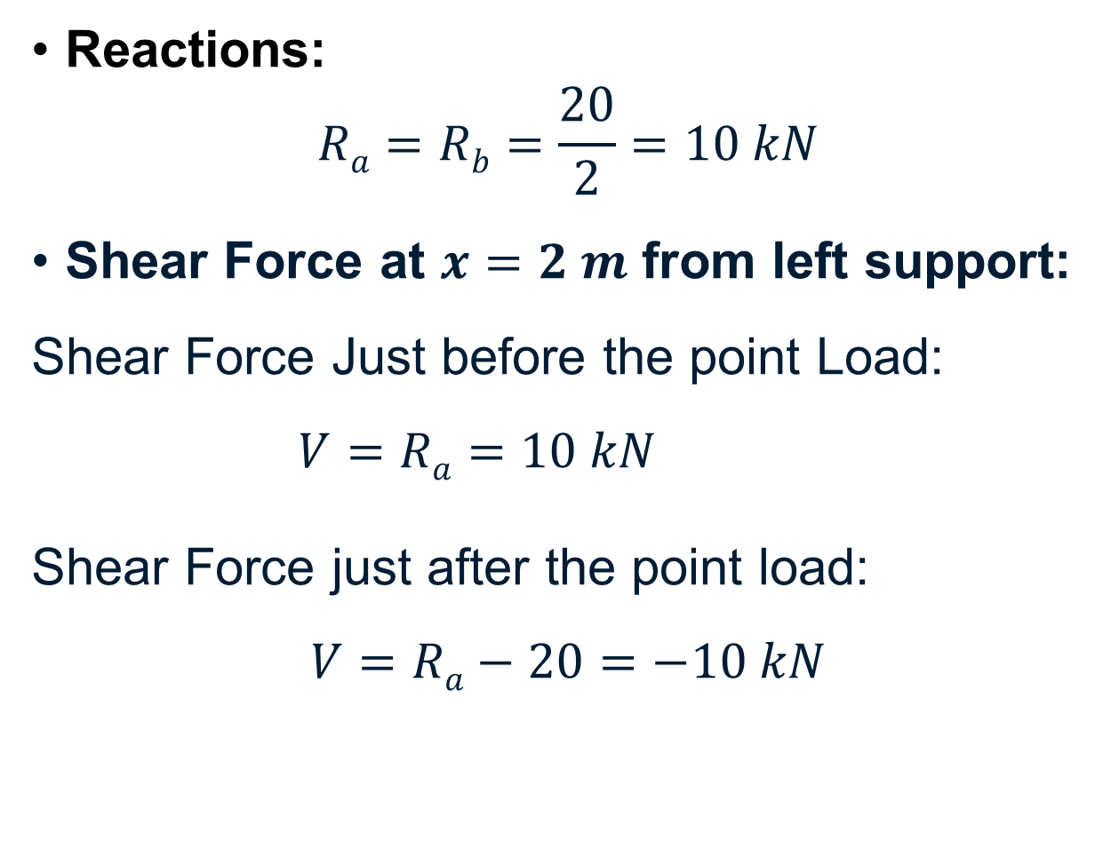
Solution
Reactions:
$$Ra=Rb=\frac{20}{2}=10 kN$$
Shear Force at $x=2 m$ from left support:
Shear Force Just before the point Load:
$V=Ra=10 kN$
Shear Force just after the point load:
$$V=Ra−20=−10 kN$$
20 KN
3m
3m
6m

Slide 55
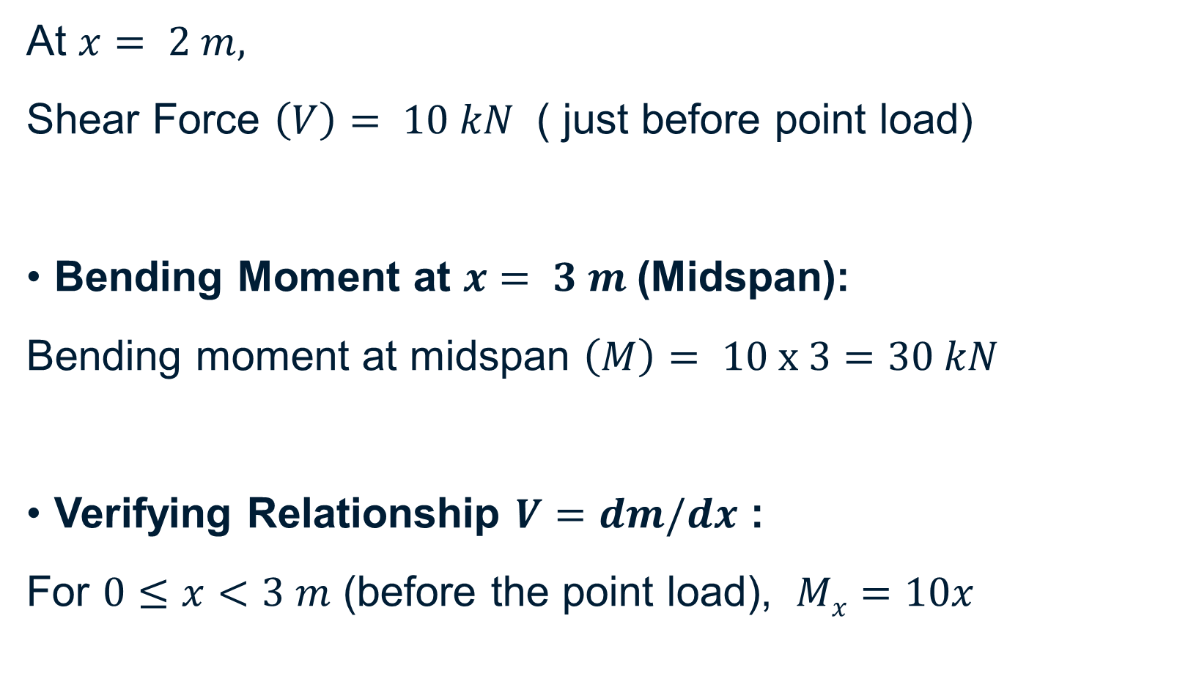
Solution …(cont’d)
At $x= 2 m,$
Shear Force $\left(V\right)= 10 kN$ ( just before point load)
Bending Moment at $x= 3 m$(Midspan):
Bending moment at midspan $\left(M\right)= 10 x 3=30 kN$
Verifying Relationship $V=dm/dx$ :
For $0≤x<3 m$ (before the point load), $Mx=10x$

Slide 56
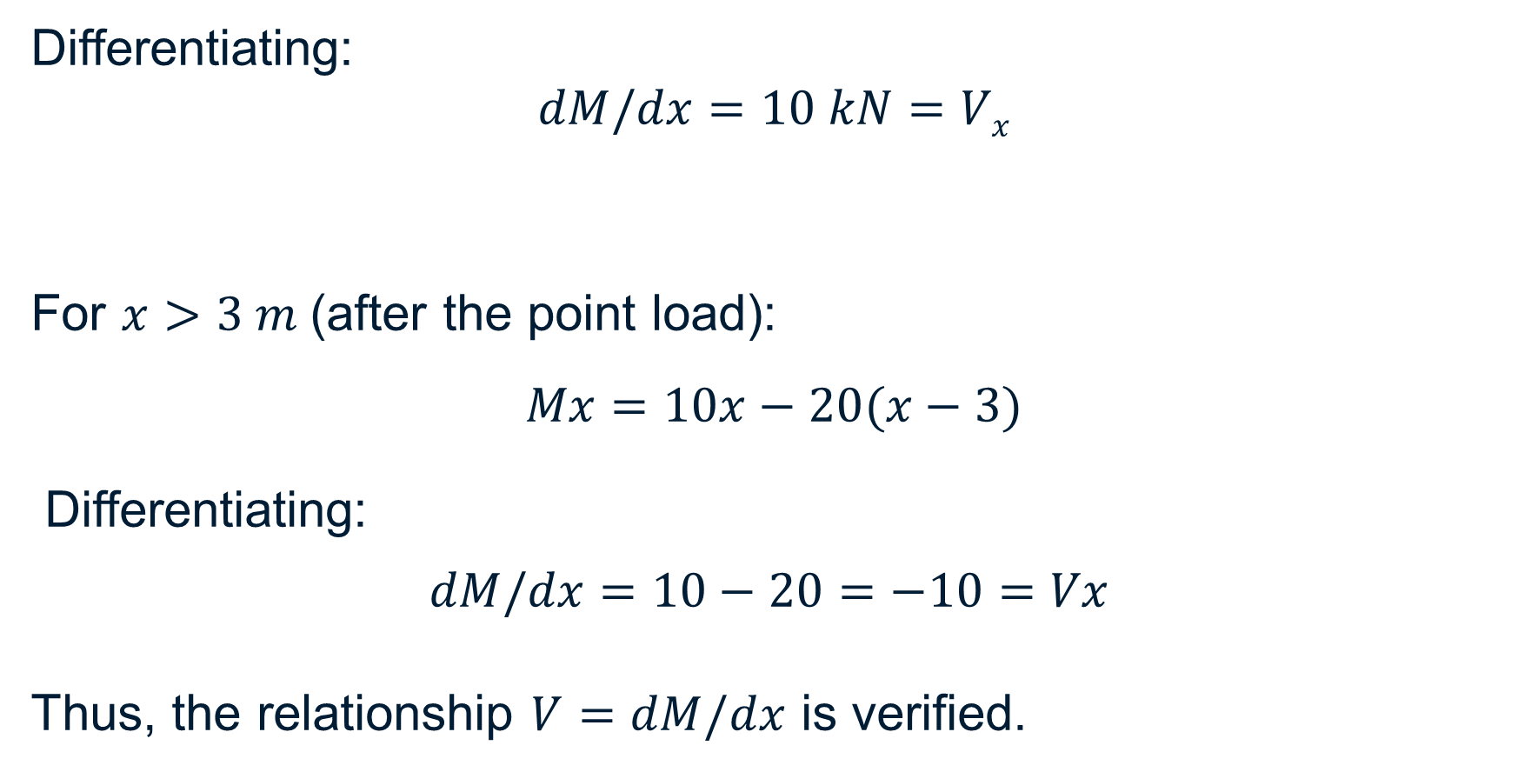
Solution …(cont’d)
Differentiating:
$$dM/dx=10 kN=Vx$$
For $x>3 m$(after the point load):
$$Mx=10x−20(x−3)$$
Differentiating:
$$dM/dx=10−20=−10=Vx​$$
Thus, the relationship $V=dM/dx$​ is verified.

Slide 57
Deflections by Twice-Integration Method & Integration of the Shear-Force and Load Equations

Slide 58
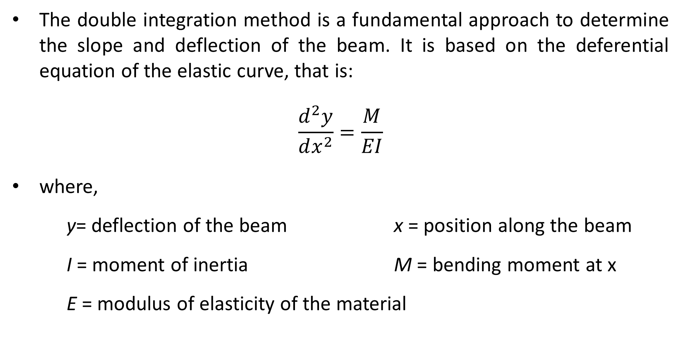
Double Integration Method
The double integration method is a fundamental approach to determine the slope and deflection of the beam. It is based on the deferential equation of the elastic curve, that is:
$$\frac{ⅆ^{2}y}{ⅆx^{2}}=\frac{M}{EI}$$
where,
y= deflection of the beam x = position along the beam
I = moment of inertia M = bending moment at x
E = modulus of elasticity of the material
Moment Equation

Slide 59
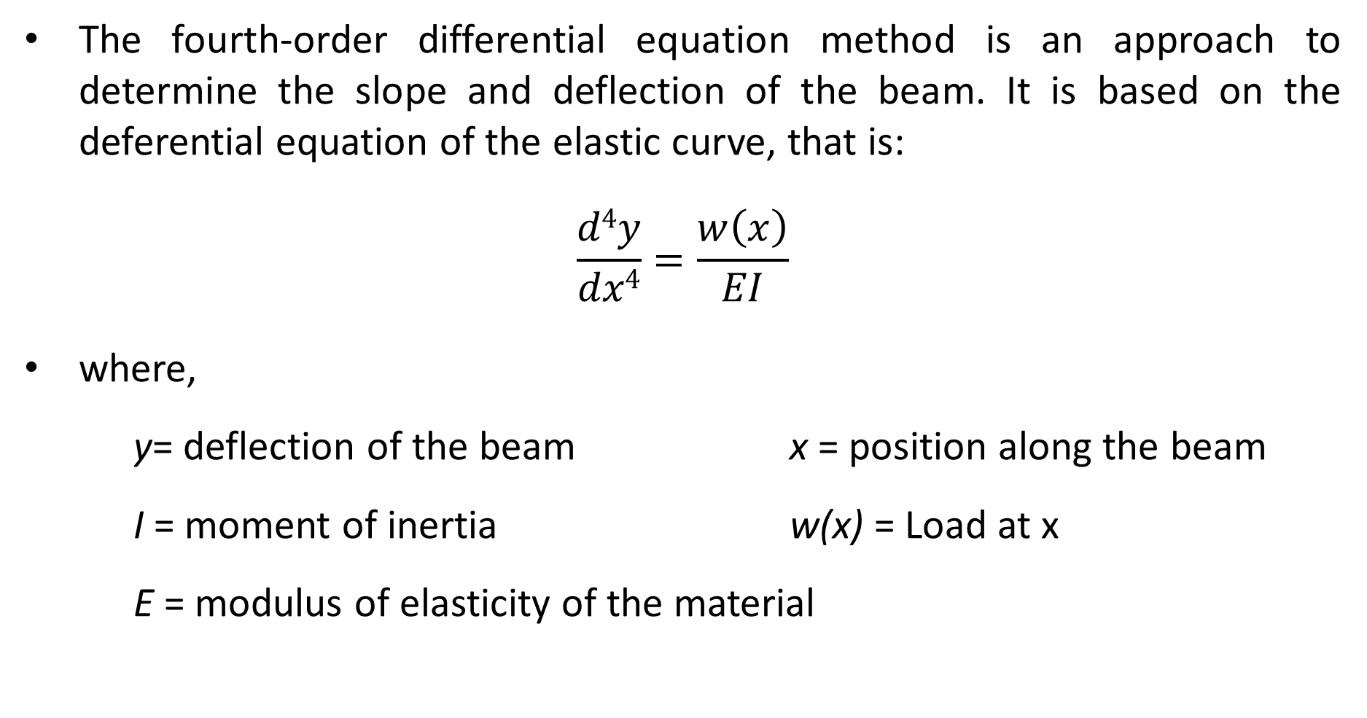
Fourth Order Differential Equation
The fourth-order differential equation method is an approach to determine the slope and deflection of the beam. It is based on the deferential equation of the elastic curve, that is:
$$\frac{d4y}{dx4}=\frac{w\left(x\right)}{EI}$$
where,
y= deflection of the beam x = position along the beam
I = moment of inertia w(x) = Load at x
E = modulus of elasticity of the material
Load Equation

Slide 60
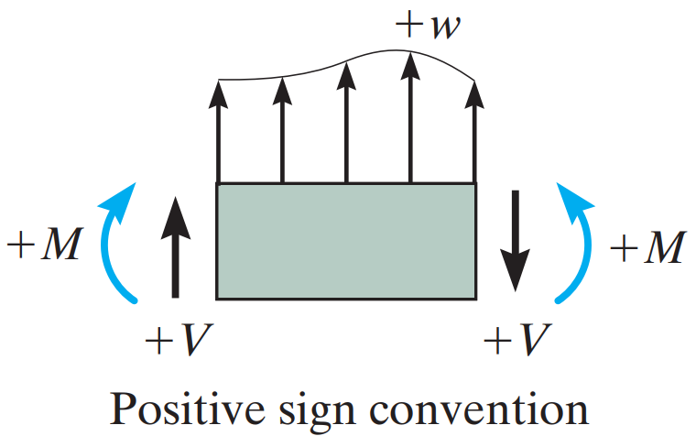
Sign Convention
Positive deflection is Upwards
Positive slope angle is measured Counter-clockwise from the x-axis when x is positive to the right.

Slide 61
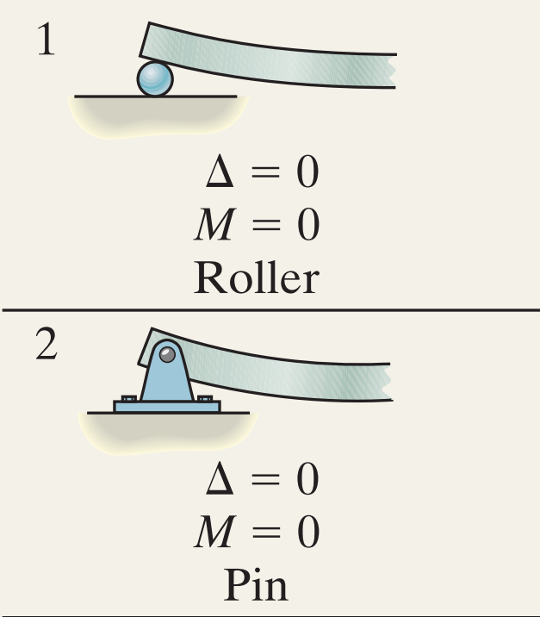
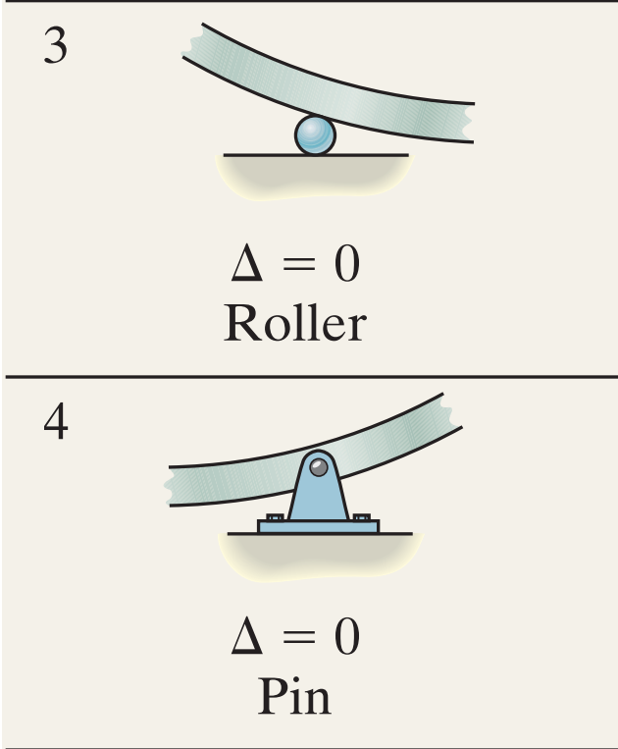
Boundary Conditions

Slide 62
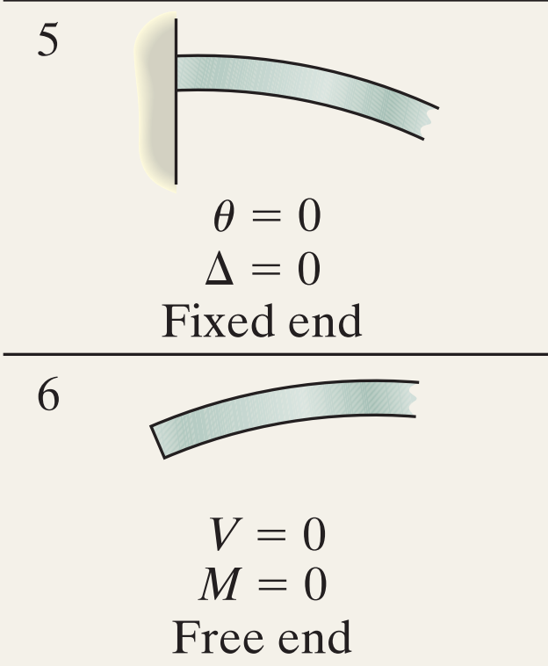
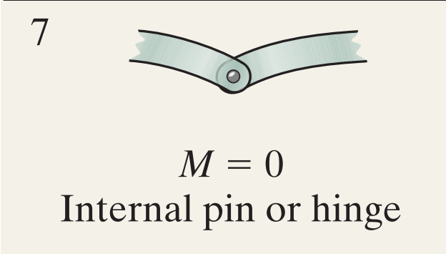
Boundary Conditions …(contd)

Slide 63
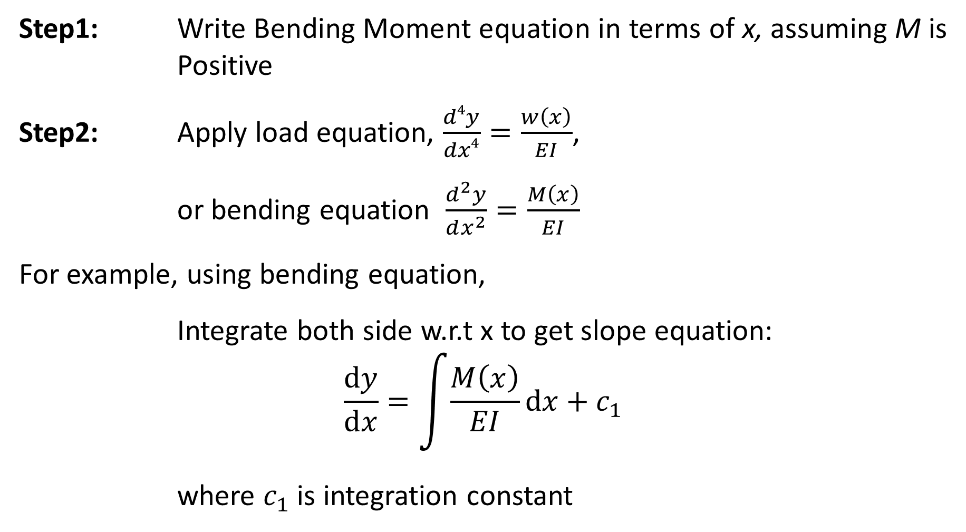
Procedure
Step1: Write Bending Moment equation in terms of x, assuming M is Positive
Step2: Apply load equation, $\frac{d4y}{dx4}=\frac{w\left(x\right)}{EI}$,
or bending equation $\frac{ⅆ^{2}y}{ⅆx^{2}}=\frac{M\left(x\right)}{EI}$
For example, using bending equation,
Integrate both side w.r.t x to get slope equation:
$$\frac{ⅆy}{ⅆx}=\int{\frac{M\left(x\right)}{EI}ⅆx}+c_{1}$$
where $c_{1}$ is integration constant

Slide 64

Procedure …(contd)
Step 3: Integrate again to get deflection
$$y=\int{\left(\frac{ⅆy}{ⅆx}\right)ⅆx}+c_{2}$$
where $c_{2}$ is another integration constant
Step 4: Apply boundary condition to get $c_{1}$ and $c_{2}$
Simply Supported Beam : at support y= 0, at centre (if symmetric loading) slope $\left(θ\right)=0$
Cantilever Beam : at fixed end y = 0 and $\left(θ\right)=0$

Slide 65

Example
A beam is subjected to distributed loading, as shown. The deflection of the beam is also shown. EI is constant.
Determine the reaction at A.

Slide 66


Solution
Step 1 : Write moment equation
$M=A_{y}x−\frac{1}{6}w_{0}\frac{x^{3}}{L}$
Step 2 : Apply deflection ${\text{eq}}^{n}$
$\frac{ⅆ^{2}y}{ⅆx^{2}}=\frac{M}{EI}$ = $\frac{A_{y}x−\frac{1}{6}w_{0}\frac{x^{3}}{L}}{EI}$
$⇒\frac{{EIⅆ}^{2}y}{ⅆx^{2}}$ = $A_{y}x−\frac{1}{6}w_{0}\frac{x^{3}}{L}$
Integrate both sides w.r.t. x to get slope equation:
$EI\frac{ⅆy}{ⅆx}=\frac{1}{2}A_{y}x^{2}−\frac{1}{24}w_{0}\frac{x^{4}}{L}+C_{1}$

Slide 67

Solution …(cont’d)
Step 3 : Integrate again to get deflection
$$EIy=\frac{1}{6}A_{y}x^{3}−\frac{1}{120}w_{0}\frac{x^{5}}{L}+C_{1}x+C_{2}$$
Step 4 : Apply boundary condition to get $c_{1}$ and $c_{2}$
at, x = 0, y = 0; 0 = 0 – 0 + 0 + $C_{2}$
at x = L, $\frac{ⅆy}{ⅆx}=$0 ; $0=\frac{1}{2}AyL2−\frac{1}{24}w_{0}L^{3}+C_{1}$
at x = L , y = 0 ; $0=\frac{1}{6}A_{y}L^{3}−\frac{1}{120}w_{0}L^{4}+C_{1}L+C_{2}$

Slide 68

Solution …(cont’d)
Solving the three equations, $c_{1}=\frac{1}{120}w_{0}L^{3} ,$ $c_{2}=0$
$A_{y}=\frac{1}{10}w_{0}L$

Slide 69
Macaulay’s Method

Slide 70

Macaulay’s Method
This method is useful when the bending moment equation changes with in the span of the beam
Non uniform loading on a beam
If the beam has concentrated point loads or concentrated moment loads, this method is preferred for analysis
This method is not preferred in case of non-prismatic sections

Slide 71

Discontinuity Functions
In order to express the load on the beam or the internal moment within it using a single expression, we will use mathematical operators known as Discontinuity Functions.
In terms of solid mechanics and beam / shaft deflections, these functions can also be called as Macaulay Functions.
These functions can be written in general form as:

Slide 72

Discontinuity Functions …cont’d
Here x represents the coordinate position of a point along the beam, and $a$ is the location on the beam where a “discontinuity” occurs, namely the point where a distributed loading begins.

Slide 73

Application of Macaulay’s Functions

Slide 74



Singularity Functions
These functions are only used to describe the point location of concentrated forces or couple moments acting on a beam or shaft.
Specifically, a concentrated force P can be considered as a special case of a distributed loading, where the intensity of the loading is $w=\frac{P}{∈}$such that its length is $∈$where $∈→0$

Slide 75


Singularity Functions …cont’d
The area under this loading diagram is equivalent to P, $positive upward$, and so we will use the singularity function :
The function takes on the value of $P$ only at the point $x=a$ where the load occurs, otherwise it is zero.

Slide 76



Singularity Functions …cont’d
In a similar manner, a couple moment $M_{0}$ ,considered positive clockwise , is a limit as $∈→0$of two distributed loadings, as shown.
Here the following function describes its value:

Slide 77
Procedure for Analysis
Elastic curve
Sketch the beam’s elastic curve and identify the boundary conditions at the supports.
Sketch the beam’s elastic curve and identify the boundary conditions at the supports.
Establish the x axis so that it extends to the right and has its origin at the beam’s left end.

Slide 78
Procedure for Analysis …cont’d
2. Load or Moment Function
Calculate the support reactions at x = 0 and then use the discontinuity functions (given in the Table) to express either the loading w or the internal moment M as a function of x. Make sure to follow the sign convention for each loading as it applies for this equation.
Note that the distributed loadings must extend all the way to the beam’s right end to be valid. If this does not occur, use the method of superposition.

Slide 79

Procedure for Analysis …cont’d
3. Slope and elastic Curve
Substitute $w$ into $EI\frac{d^{4}v}{dx^{4}}$ $= w(x)$, or $M$ into the moment curvature relation $EI\frac{d^{2}v}{dx^{2}}$ = $M$, and integrate to obtain the equations for the beam’s slope and deflection.
Evaluate the constants of integration using the boundary conditions, and substitute these constants into the slope and deflection equations to obtain the final results.
When the slope and deflection equations are evaluated at any point on the beam, a positive slope is counterclockwise, and a positive displacement is upwards.

Slide 80

Example
Apply discontinuity functions to describe the loading or internal moment consider the beam loaded as shown in the figure.

Slide 81

Solution
The reactions due to loading are shown:
From the Table , the loading at any point $x$ on the beam is therefore:
$$w=2.75 kN \left\langle x−0\right\rangle −1+1.5 kN.m \left\langle x−3 m\right\rangle −2−3\frac{kN}{m} \left\langle x−3m\right\rangle 0 −1\frac{kN}{m2}\left\langle x−3 m\right\rangle 1$$

Slide 82

Solution …cont’d
The reactive force at B is not included here since x is never greater than 6 m, and also, this value is of no consequence in calculating the slope or deflection.
We can determine the moment expression directly from the Table:
$$M=2.75 kN \left\langle x−o\right\rangle 1+1.5 kN.m\left\langle x−3\right\rangle 0 −\frac{3\frac{kN}{m}}{2}\left\langle x−3 m\right\rangle 2 −\frac{1 kN/m2}{6}\left\langle x−3 m\right\rangle 3$$
$$⇒2.75x+1.5\left\langle x−3\right\rangle 0−1.5\left\langle x−3\right\rangle 2−\frac{1}{6}\left\langle x−3\right\rangle 3$$
The deflection of the beam can now be determined after this equation is integrated two successive times and the constants of integration are evaluated using the boundary conditions of zero displacement at A and B.

Slide 83
Method of superimposition for obtaining deflections in complex loading and support conditions

Slide 84

Superposition Principle
The slope and displacement at a point on a beam subjected to several different loadings can be obtained by algebraically adding the effects of its various component parts.
The differential equation EI $\frac{d^{2}v}{dx^{2}}=w\left(x\right)$ satisfies two necessary requirements:
The load w(x) is linearly related to deflection v(x).
The original geometry of the beam does not change significantly by the loads.
Thus deflection/slope at a point for a series of separate loadings acting on a beam may be superimposed.

Slide 85



Superposition Principle …cont’d
The deflection/slope at point C for the following beam may be obtained as:
Deflection/slope due to UDL
=
Deflection/slope due to point load

Slide 86



Superposition Principle …cont’d
As an example, the deflection at point C for the beam may be obtained as:
$$v_{c1}=\frac{5wL^{4}}{768EI}$$
$${v_{c}=v}_{c1}+v_{c2}=\frac{5wL^{4}}{768EI}+\frac{PL^{3}}{48EI}$$
$$v_{c2}=\frac{PL^{3}}{48EI}$$

Slide 87
Superposition Principle - Application
Similar procedure can be adopted to find slope at any point in a beam with several loading cases applied on the beam.
Tabulated results for various beam loadings (as shown next) can be employed to find slope/displacement at any point of a beam by separating the different load cases and adopting the same procedure as above.
In case of overhangs, the beam can be first converted into a simply supported beam and a cantilever beam, and then employ the procedure already developed for these simple cases separately.

Slide 88


Slide 89


Slide 90


Slide 91


Slide 92

Example
Determine the displacement at the end C of the cantilever beam.

Slide 93

SOLUTION
The slope and displacement at point B of the beam are:
$$θB=\frac{w0L3}{24EI}=\frac{4 kN/m\left(6 m\right)3}{24EI}=\frac{36 kN.m2}{EI}$$
$$υB=\frac{w0L4}{30EI}=\frac{4 kN\left(6 m\right)4}{30EI}=\frac{172.8 kN.m3}{EI}$$

Slide 94



SUPERPOSITION PRINCIPLE : SOLVED EXAMPLE
The unloaded region BC remains straight. Also since $θ_{B}$ is small, the displacement at
C becomes
$$υC=υB+θB\left(LBC\right)$$
=$\frac{172.8 kN.m3}{EI}+\frac{36 kN.m2}{EI}\left(2m\right)$
=$\frac{244.8 kN.m3}{EI}$

